Slide 1
热物（第十五六周）
Mean Field Theory solution of the Ising model

Slide 2
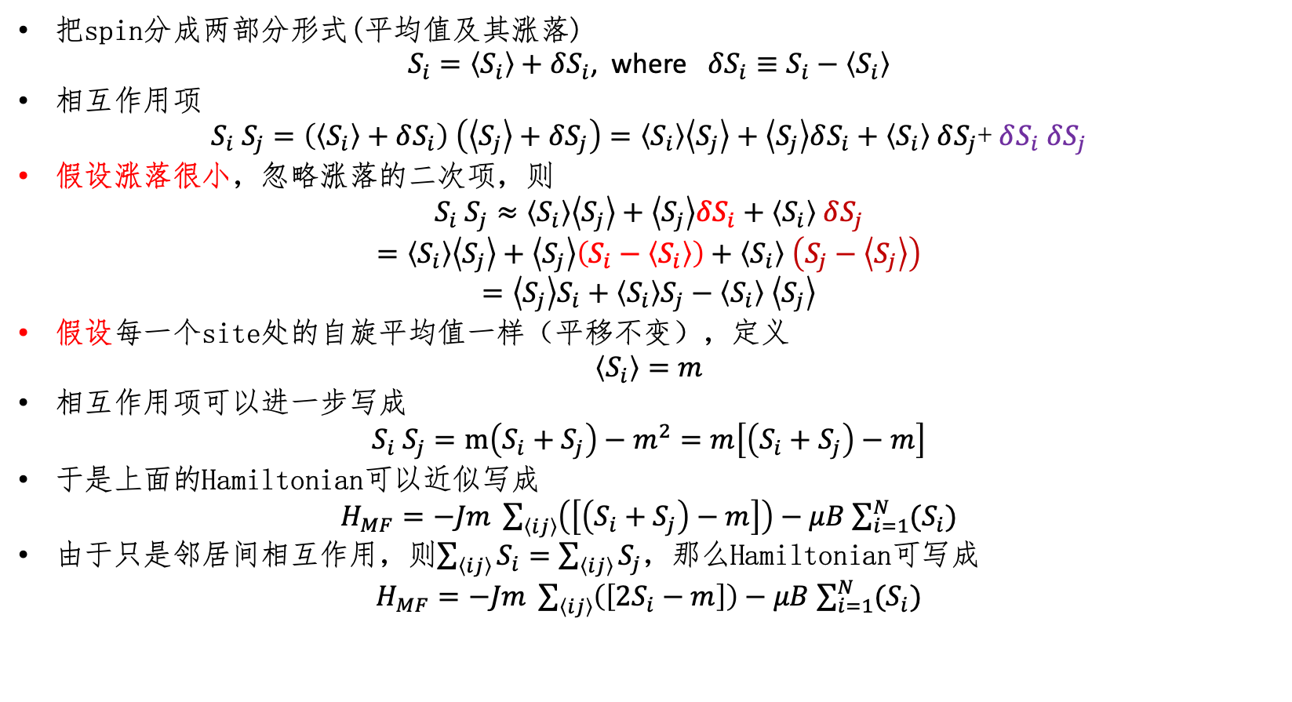
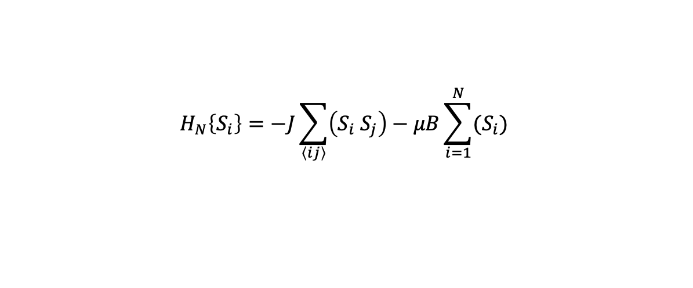
$$H_{N}\left\{S_{i}\right\}=−J\sum_{\left\langle ij\right\rangle }{\left(S_{i} S_{j}\right)−μB\sum_{i=1}^{N}{(S_{i})}}$$
Decoupling the Hamiltonian
把spin分成两部分形式(平均值及其涨落)
$S_{i}=\left\langle S_{i}\right\rangle +δS_{i}$, where $δS_{i}≡S_{i}−\left\langle S_{i}\right\rangle$
相互作用项
$S_{i} S_{j}=\left(\left\langle S_{i}\right\rangle +δS_{i}\right) \left(\left\langle S_{j}\right\rangle +δS_{j}\right)=\left\langle S_{i}\right\rangle \left\langle S_{j}\right\rangle +\left\langle S_{j}\right\rangle δS_{i}+\left\langle S_{i}\right\rangle$ $δS_{j}$+ $δS_{i}$ $δS_{j}$
假设涨落很小，忽略涨落的二次项，则
$S_{i} S_{j}≈\left\langle S_{i}\right\rangle \left\langle S_{j}\right\rangle +\left\langle S_{j}\right\rangle δS_{i}+\left\langle S_{i}\right\rangle$ $δS_{j}$
$$=\left\langle S_{i}\right\rangle \left\langle S_{j}\right\rangle +\left\langle S_{j}\right\rangle \left(S_{i}−\left\langle S_{i}\right\rangle \right)+\left\langle S_{i}\right\rangle \left(S_{j}−\left\langle S_{j}\right\rangle \right)$$
$=\left\langle S_{j}\right\rangle S_{i}+\left\langle S_{i}\right\rangle S_{j}−\left\langle S_{i}\right\rangle$ $\left\langle S_{j}\right\rangle$
假设每一个site处的自旋平均值一样（平移不变），定义
$$\left\langle S_{i}\right\rangle =m$$
相互作用项可以进一步写成
$$S_{i} S_{j}=m\left(S_{i}+S_{j}\right)−m^{2}=m\left[\left(S_{i}+S_{j}\right)−m\right]$$
于是上面的Hamiltonian可以近似写成
$H_{MF}=−Jm \sum_{\left\langle ij\right\rangle }{\left(\left[\left(S_{i}+S_{j}\right)−m\right]\right)}−μB$ $\sum_{i=1}^{N}{(S_{i})}$
由于只是邻居间相互作用，则$\sum_{\left\langle ij\right\rangle }{S_{i}=\sum_{\left\langle ij\right\rangle }{S_{j}}}$，那么Hamiltonian可写成
$H_{MF}=−Jm \sum_{\left\langle ij\right\rangle }{\left(\left[2S_{i}−m\right]\right)}−μB$ $\sum_{i=1}^{N}{(S_{i})}$

Slide 3
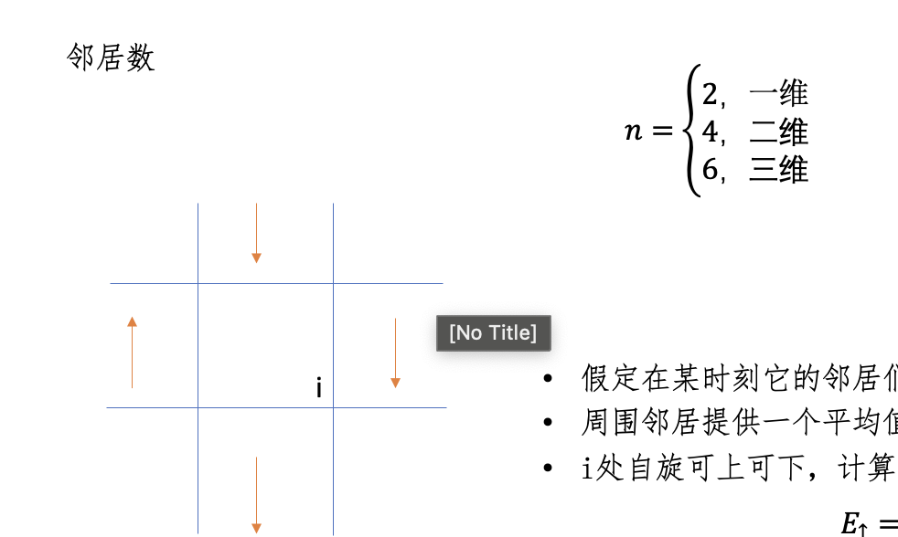
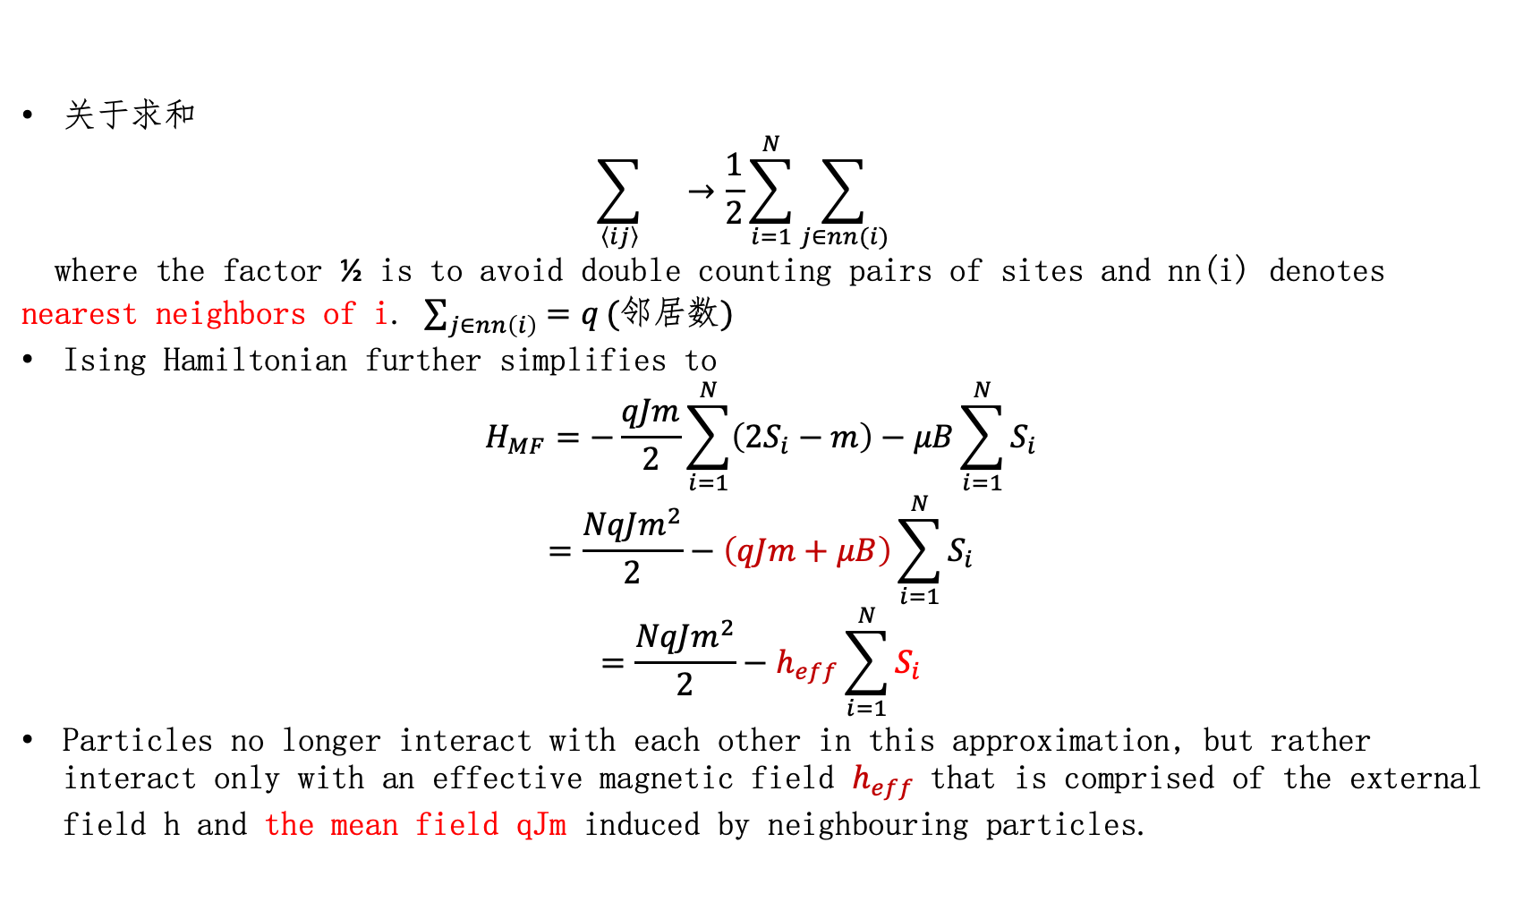
关于求和
$$\sum_{\left\langle ij\right\rangle }{}→\frac{1}{2}\sum_{i=1}^{N}{\sum_{j∈nn(i)}{}}$$
where the factor ½ is to avoid double counting pairs of sites and nn(i) denotes nearest neighbors of i. $\sum_{j∈nn\left(i\right)}{=q}(邻居数)$
Ising Hamiltonian further simplifies to
$$H_{MF}=−\frac{qJm}{2}\sum_{i=1}^{N}{\left(2S_{i}−m\right)−μB\sum_{i=1}^{N}{S_{i}}}$$
$$=\frac{NqJm^{2}}{2}−\left(qJm+μB\right)\sum_{i=1}^{N}{S_{i}}$$
$$=\frac{NqJm^{2}}{2}−h_{eff}\sum_{i=1}^{N}{S_{i}}$$
Particles no longer interact with each other in this approximation, but rather interact only with an effective magnetic field $h_{eff}$that is comprised of the external field h and the mean field qJm induced by neighbouring particles.

Slide 4
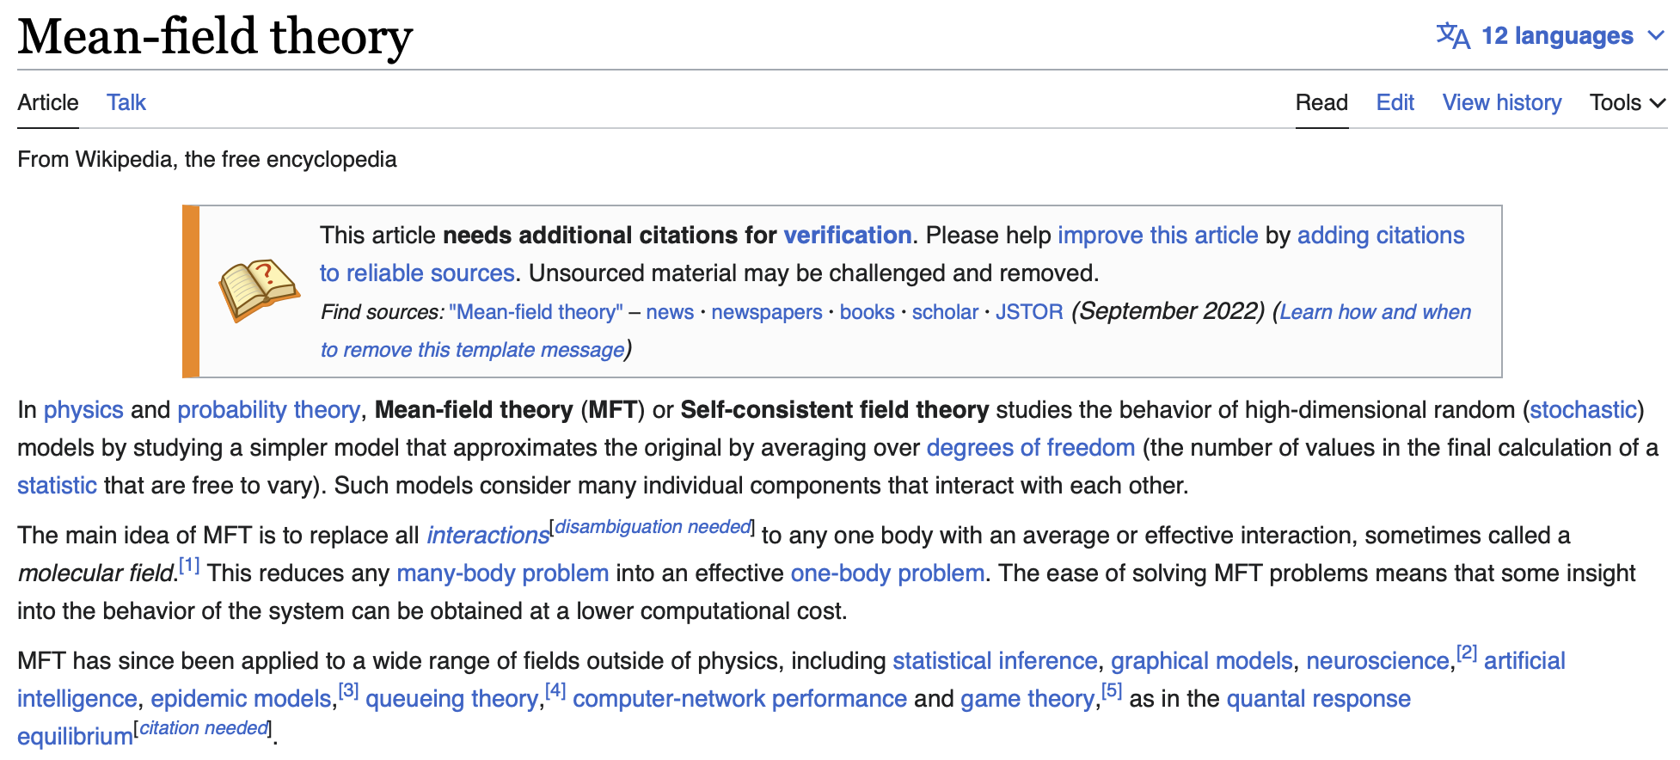
Reduce many-body problem into an effective one-body problem!
Applied to a wide range of fields outside of physics…(Mean-field game theory)

Slide 5
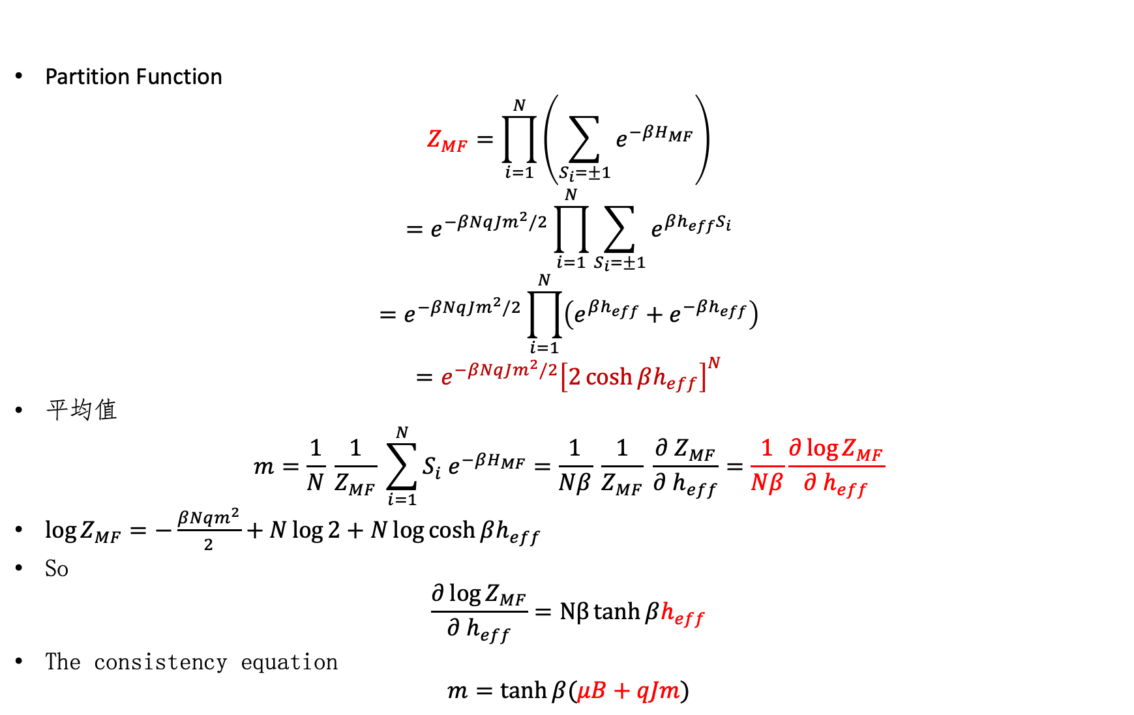
Self-consistency equation
Partition Function
$$Z_{MF}=\prod_{i=1}^{N}{\left(\sum_{S_{i}=±1}{e^{−βH_{MF}}}\right)}$$
$$=e^{−βNqJm^{2}/2}\prod_{i=1}^{N}{\sum_{S_{i}=±1}{e^{βh_{eff}S_{i}}}}$$
$$=e^{−βNqJm^{2}/2}\prod_{i=1}^{N}{\left(e^{βh_{eff}}+e^{−βh_{eff}}\right)}$$
$$=e^{−βNqJm^{2}/2}{\left[2\cosh{βh_{eff}}\right]}^{N}$$
平均值
$$m=\frac{1}{N} \frac{1}{Z_{MF}} \sum_{i=1}^{N}{S_{i} e^{−βH_{MF}}}=\frac{1}{Nβ} \frac{1}{Z_{MF}} \frac{∂ Z_{MF}}{∂ h_{eff}}=\frac{1}{Nβ}\frac{∂\log{Z_{MF}}}{∂ h_{eff}}$$
$\log{Z_{MF}=−\frac{βNqm^{2}}{2}+N\log{2+N\log{\cosh{βh_{eff}}}}}$
So
$$\frac{∂\log{Z_{MF}}}{∂ h_{eff}}=Nβ\tanh{βh_{eff}}$$
The consistency equation
$$m=\tanh{β(μB+qJm)}$$

Slide 6
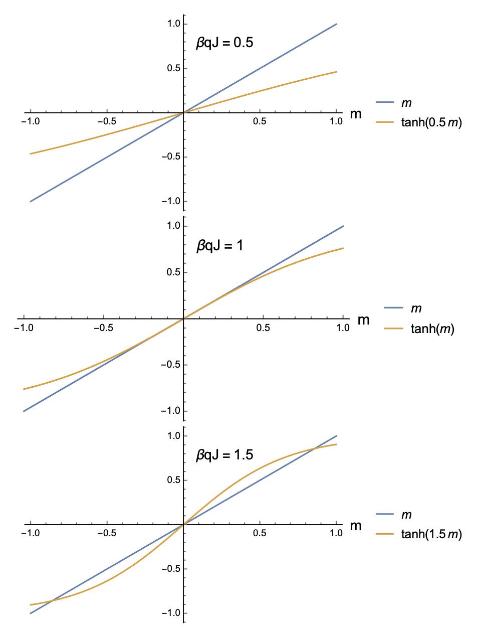
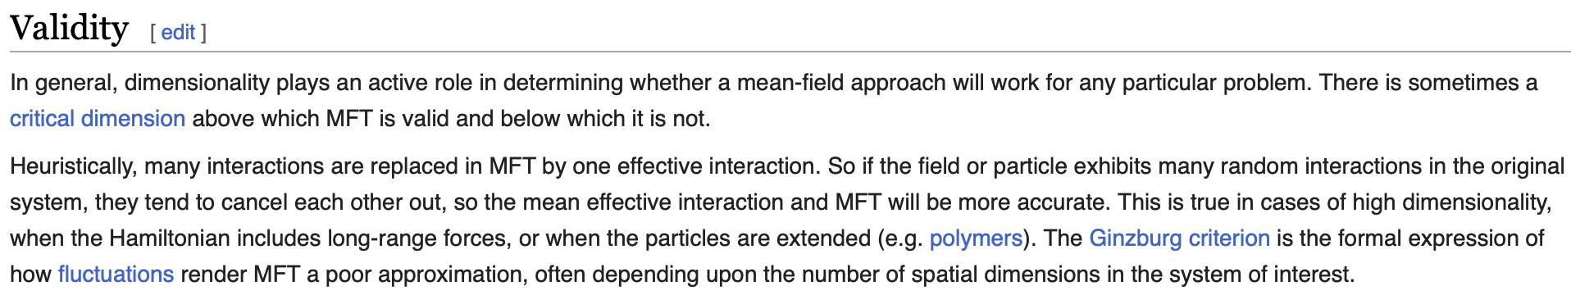
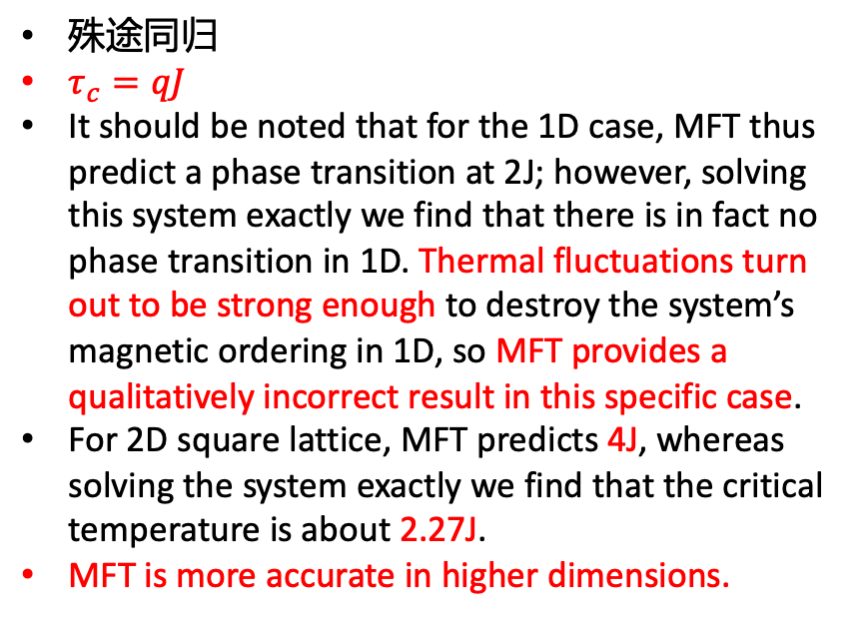
外场为零情况
殊途同归
$τ_{c}=qJ$
It should be noted that for the 1D case, MFT thus predict a phase transition at 2J; however, solving this system exactly we find that there is in fact no phase transition in 1D. Thermal fluctuations turn out to be strong enough to destroy the system’s magnetic ordering in 1D, so MFT provides a qualitatively incorrect result in this specific case.
For 2D square lattice, MFT predicts 4J, whereas solving the system exactly we find that the critical temperature is about 2.27J.
MFT is more accurate in higher dimensions.

Slide 7
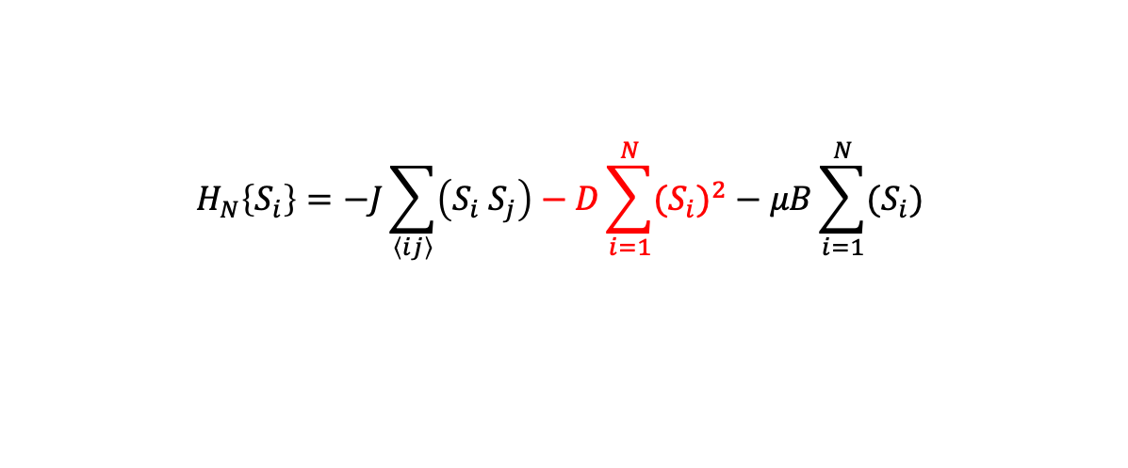
随堂测试（10分钟）
$$H_{N}\left\{S_{i}\right\}=−J\sum_{\left\langle ij\right\rangle }{\left(S_{i} S_{j}\right)−D\sum_{i=1}^{N}{{(S_{i})}^{2}}−μB\sum_{i=1}^{N}{(S_{i})}}$$
修改Hamiltonian如上，请给出平均场理论下的有效Hamiltonian，并给出平均自旋的自洽方程

Slide 8

回答上次课一个遗留问题

Slide 9
回答上次课一个遗留问题
判据一：自由能极小

Slide 10
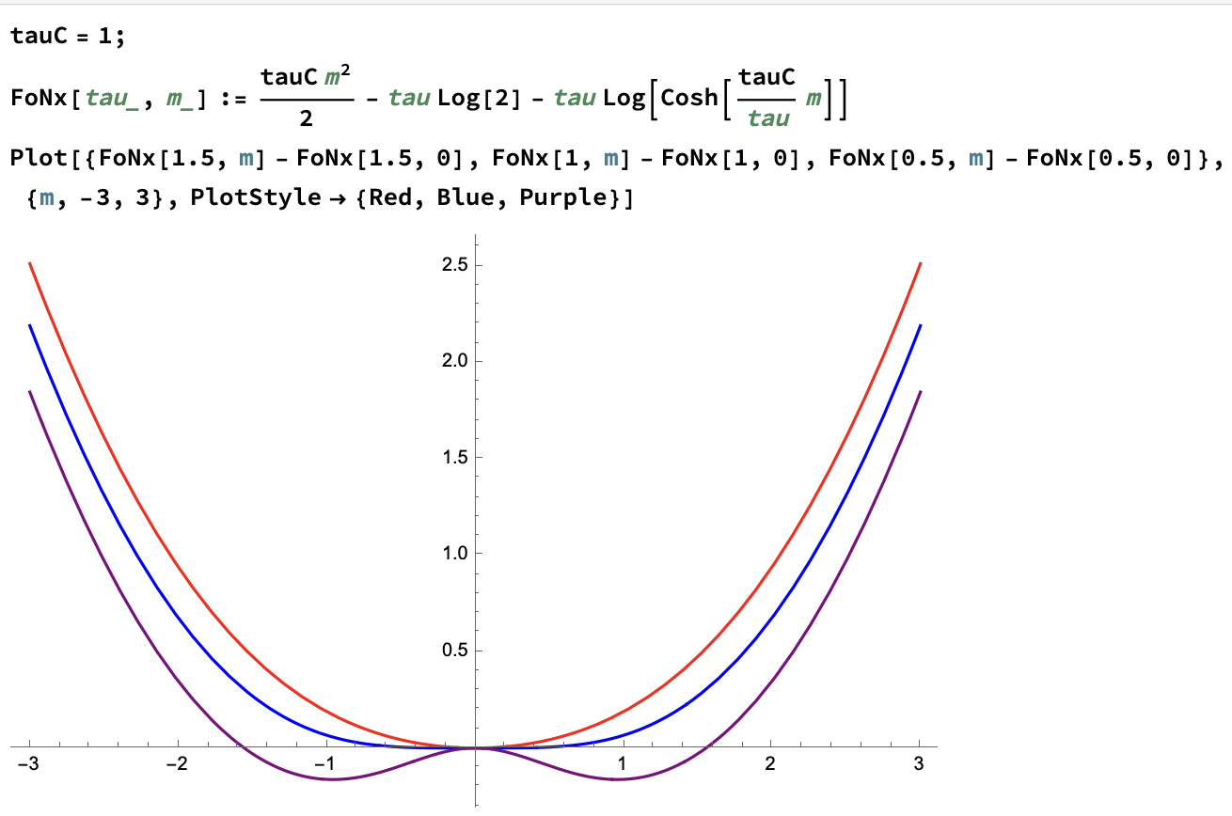
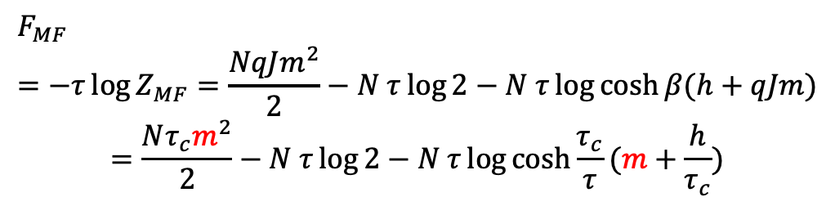
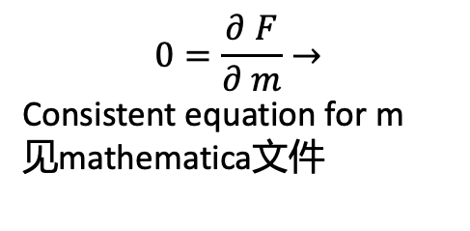

Free Energy
$$Z_{MF}=e^{−βNqJm^{2}/2}{\left[2\cosh{βh_{eff}}\right]}^{N}$$
$$F_{MF}=−τ\log{Z_{MF}=\frac{NqJm^{2}}{2}−N τ\log{2}−N τ\log{\cosh{β(h+qJm)}}}$$
$$=\frac{Nτ_{c}m^{2}}{2}−N τ\log{2}−N τ\log{\cosh{\frac{τ_{c}}{τ}(m+\frac{h}{τ_{c}})}}$$
在特定的m解下，F固定
我们可以比较F的大小来确定哪个解代表的真实的解
为了方便，假设m可变，从而可以画F随着m的变化
从而更为形象
$μB$=0
见mathematica文件 FreeEnergy.nb
$$0=\frac{∂ F}{∂ m}→$$
Consistent equation for m
见mathematica文件
m

Slide 11
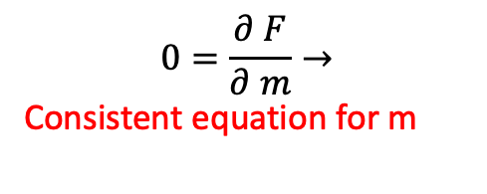
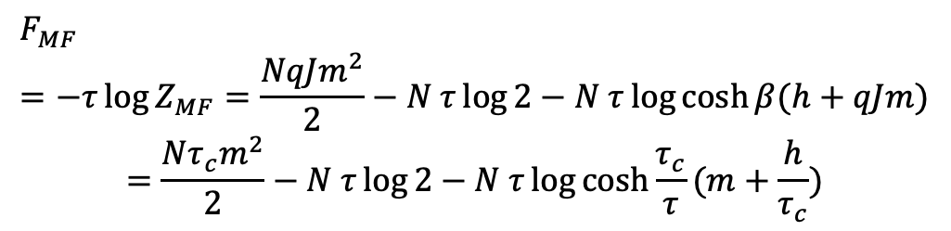
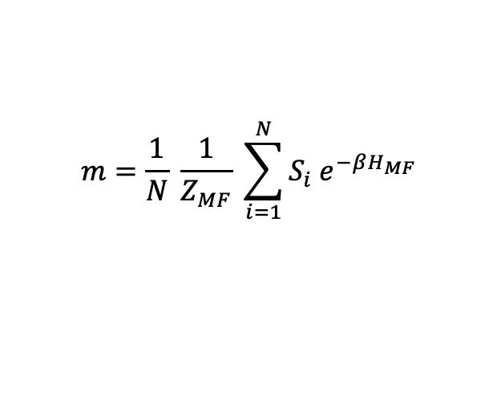
$$F_{MF}=−τ\log{Z_{MF}=\frac{NqJm^{2}}{2}−N τ\log{2}−N τ\log{\cosh{β(h+qJm)}}}$$
$$=\frac{Nτ_{c}m^{2}}{2}−N τ\log{2}−N τ\log{\cosh{\frac{τ_{c}}{τ}(m+\frac{h}{τ_{c}})}}$$
$$0=\frac{∂ F}{∂ m}→$$
Consistent equation for m
$$m=\frac{1}{N} \frac{1}{Z_{MF}} \sum_{i=1}^{N}{S_{i} e^{−βH_{MF}}}$$

Slide 12
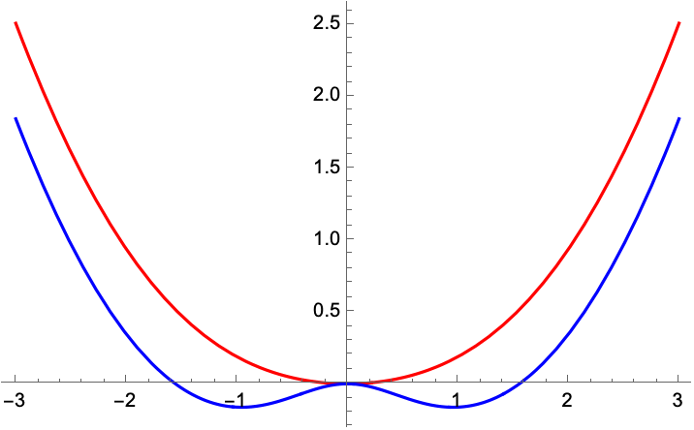
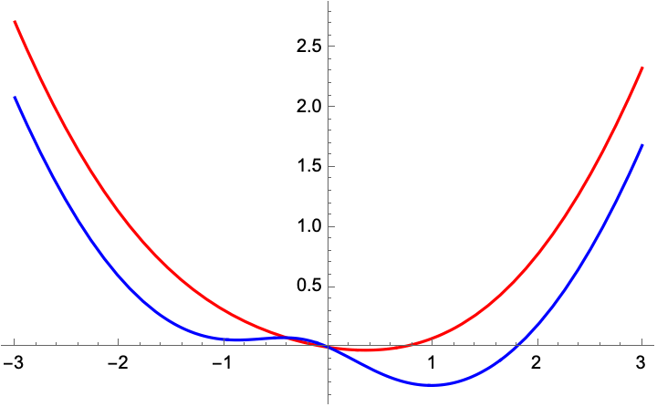
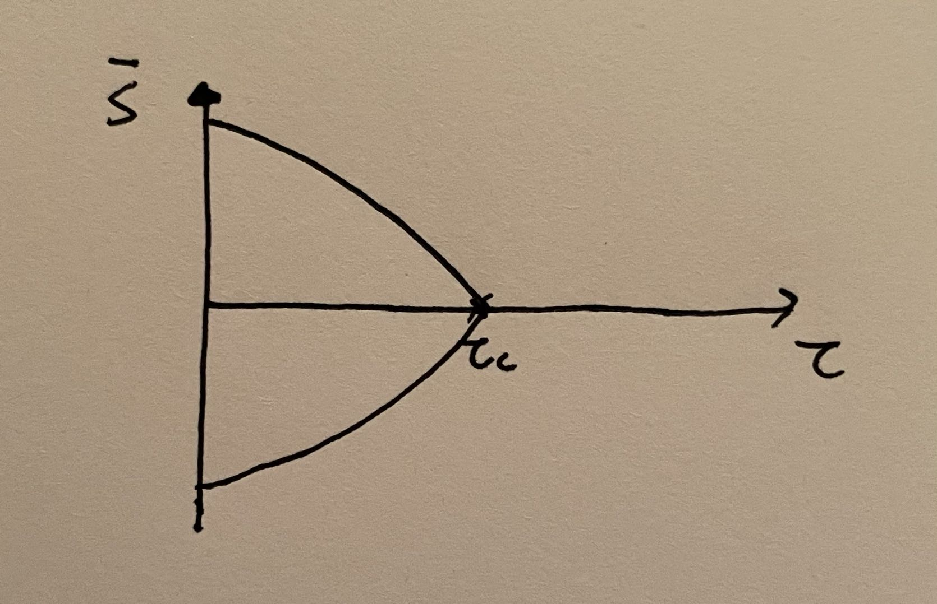
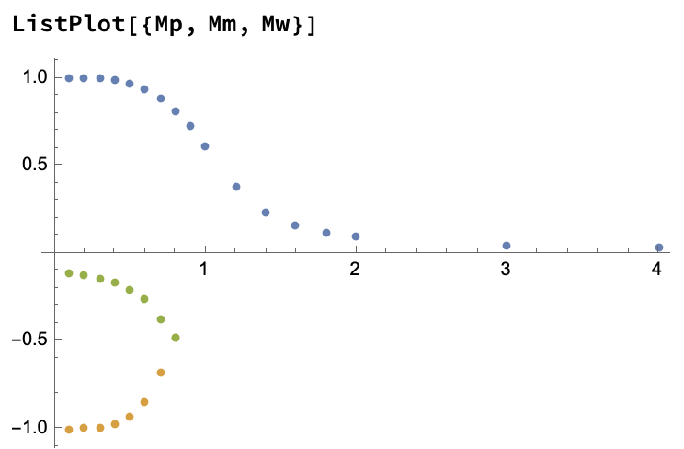
外场为零情况 (见Mathematica文件)
外场不为零情况

Slide 13
回答上次课一个遗留问题
判据二：磁化率

Slide 14

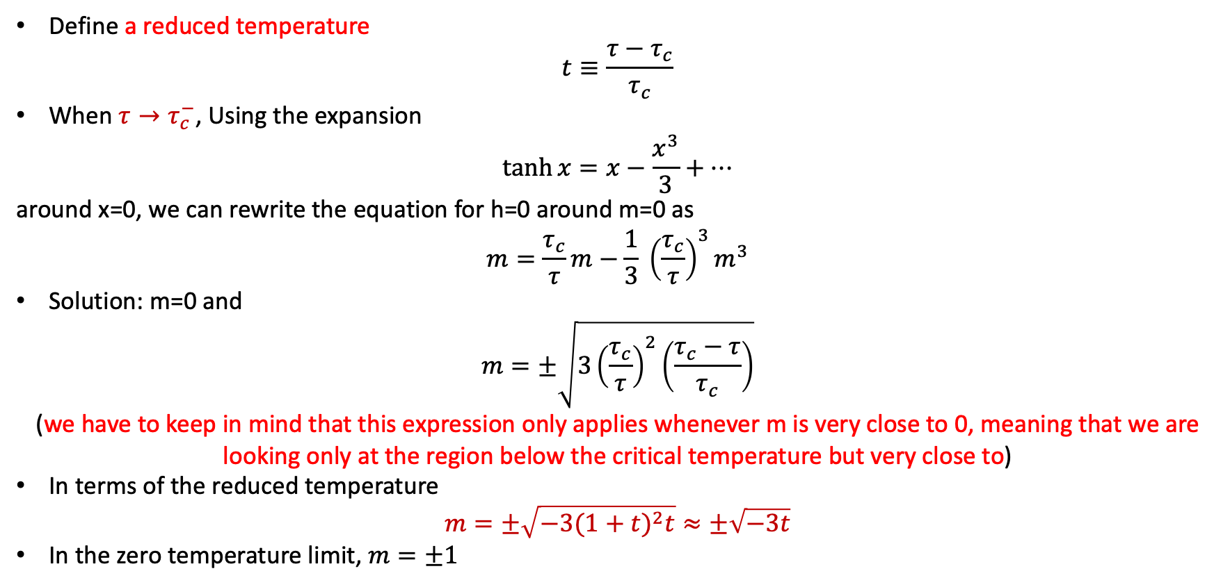
Critical behavior at zero field
$$m=\tanh{\frac{τ_{c}}{τ}m}$$
Define a reduced temperature
$$t≡\frac{τ−τ_{c}}{τ_{c}}$$
When $τ→τ_{c}^{−}$, Using the expansion
$$\tanh{x=x−\frac{x^{3}}{3}+…}$$
around x=0, we can rewrite the equation for h=0 around m=0 as
$$m=\frac{τ_{c}}{τ}m−\frac{1}{3} {\left(\frac{τ_{c}}{τ}\right)}^{3}m^{3}$$
Solution: m=0 and
$$m=±\sqrt{3{\left(\frac{τ_{c}}{τ}\right)}^{2}\left(\frac{τ_{c}−τ}{τ_{c}}\right)}$$
(we have to keep in mind that this expression only applies whenever m is very close to 0, meaning that we are looking only at the region below the critical temperature but very close to)
In terms of the reduced temperature
$$m=±\sqrt{−3{(1+t)}^{2}t}≈±\sqrt{−3t}$$
In the zero temperature limit, $m=±1$

Slide 15
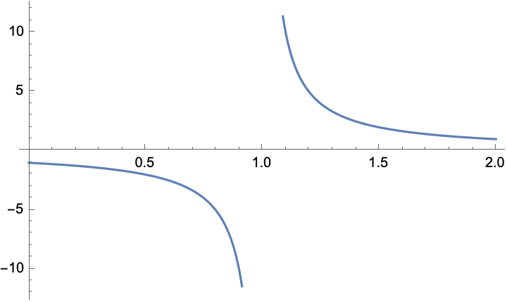
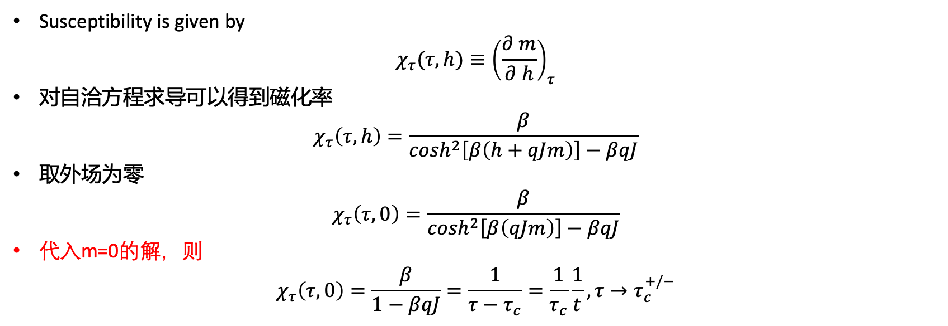

$$m=\tanh{\frac{τ_{c}}{τ}\left(m+\frac{h}{τ_{c}}\right)}$$
Susceptibility is given by
$$χ_{τ}(τ,h)≡{\left(\frac{∂ m}{∂ h}\right)}_{τ}$$
对自洽方程求导可以得到磁化率
$$χ_{τ}\left(τ,h\right)=\frac{β}{\cosh^{2}\left[β\left(h+qJm\right)\right]−βqJ}$$
取外场为零
$$χ_{τ}\left(τ,0\right)=\frac{β}{\cosh^{2}\left[β\left(qJm\right)\right]−βqJ}$$
代入m=0的解，则
$$χ_{τ}\left(τ,0\right)=\frac{β}{1−βqJ}=\frac{1}{τ−τ_{c}}=\frac{1}{τ_{c}}\frac{1}{t}, τ→τ_{c}^{+/−}$$
推导见Mathematica文件

Slide 16
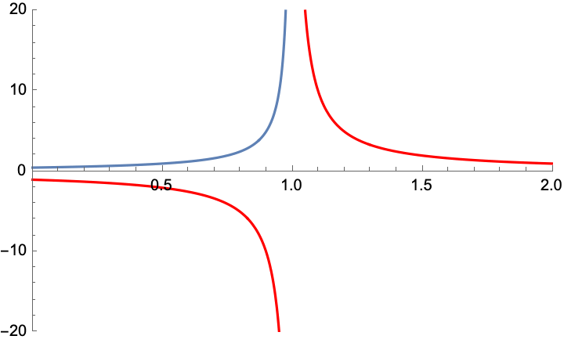


当温度从下趋于临界点时候，我们知道$m=±\sqrt{−3{(1+t)}^{2}t}≈±\sqrt{−3t}$，再利用cosh函数的taylor展开，我们可以得到
$$χ_{τ}\left(τ,0\right)≈\frac{1}{2}\frac{1}{τ_{c}}\frac{1}{|t|}, τ→τ_{c}^{−}$$
红线，m=0的解对应的磁化率
蓝线，m不等于零的解对应的磁化率
在临界点处发散
在临界点下，m=0解的磁化率取负值，物理意义？

Slide 17
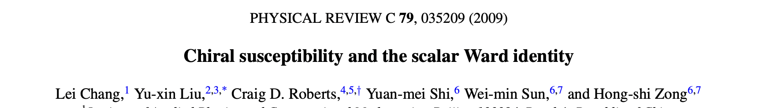
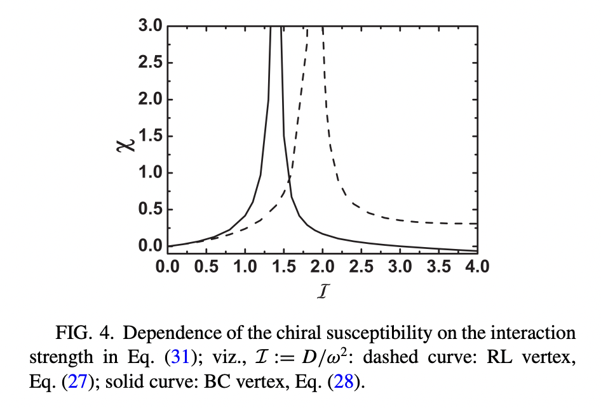
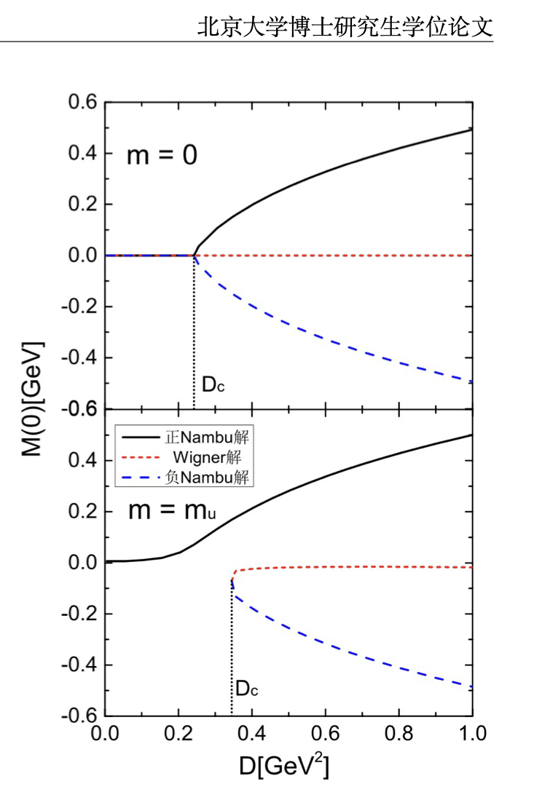

Slide 18
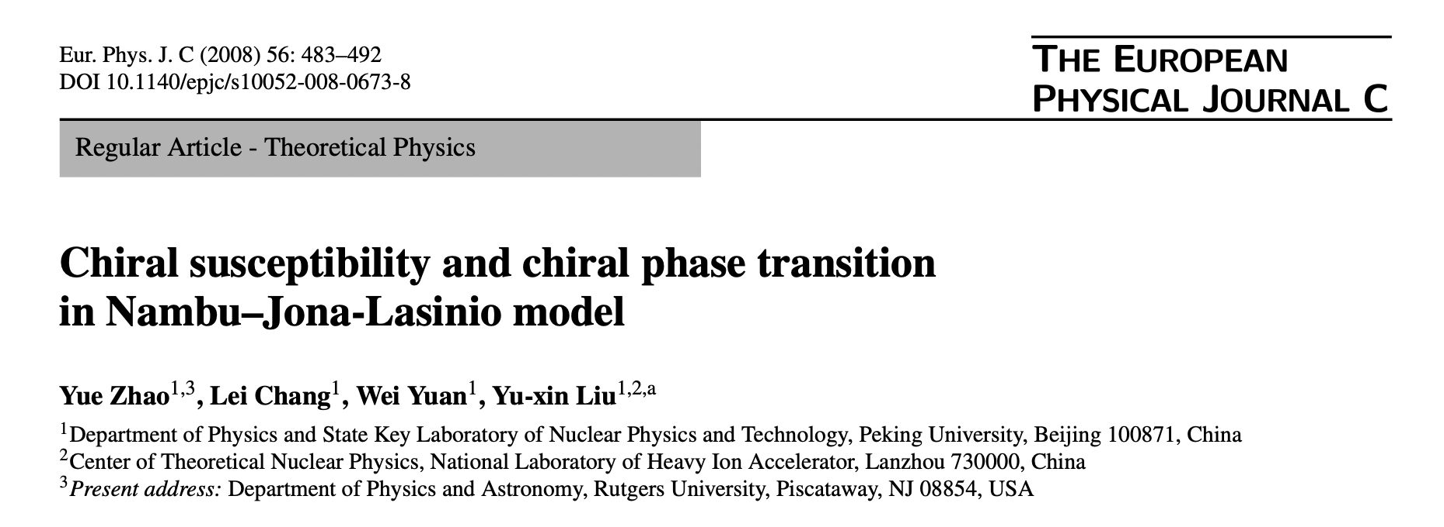
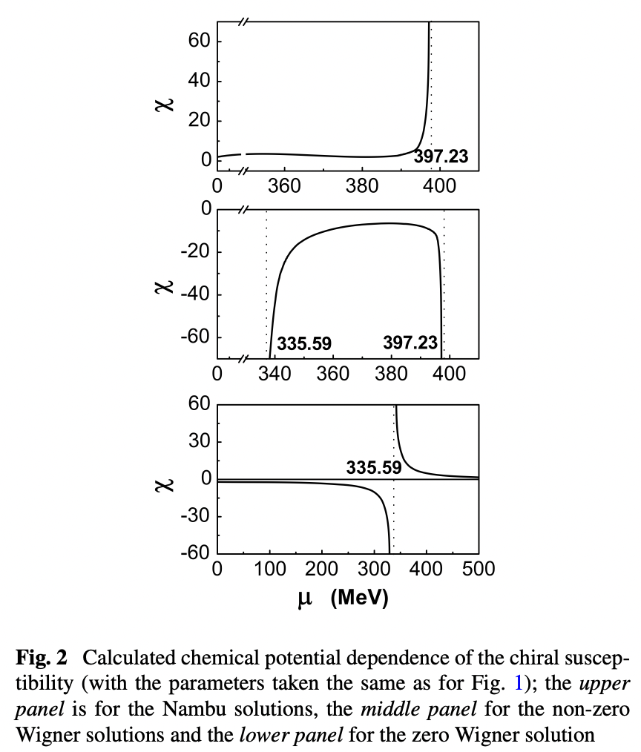
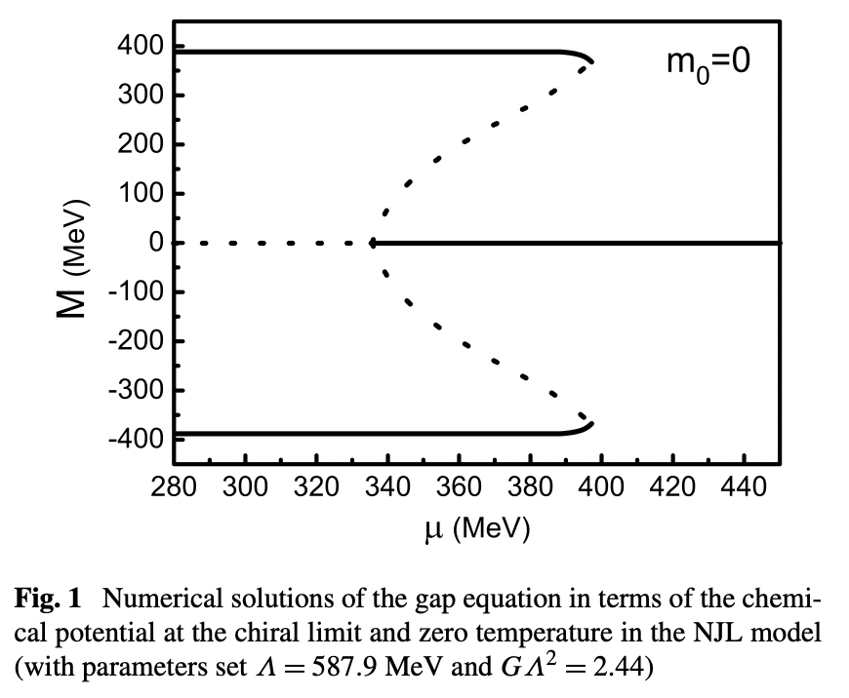

Slide 19
回答上次课一个遗留问题
判据一：自由能极小
判据二：磁化率
一致否？

Slide 20
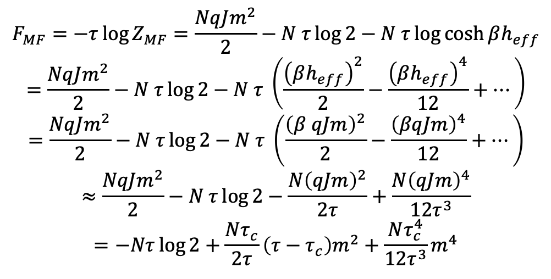


Landau Free Energy
$$Z_{MF}=e^{−βNqJm^{2}/2}{\left[2\cosh{βh_{eff}}\right]}^{N}$$
$$μB=0$$
$$F_{MF}=−τ\log{Z_{MF}=\frac{NqJm^{2}}{2}−N τ\log{2}−N τ\log{\cosh{βh_{eff}}}}$$
$$=\frac{NqJm^{2}}{2}−N τ\log{2}−N τ \left(\frac{{\left(βh_{eff}\right)}^{2}}{2}−\frac{{\left(βh_{eff}\right)}^{4}}{12}+…\right)$$
$$=\frac{NqJm^{2}}{2}−N τ\log{2}−N τ \left(\frac{{\left(β qJm\right)}^{2}}{2}−\frac{{\left(βqJm\right)}^{4}}{12}+…\right)$$
$$≈\frac{NqJm^{2}}{2}−N τ\log{2}−\frac{N{\left(qJm\right)}^{2}}{2τ}+\frac{N{\left(qJm\right)}^{4}}{12τ^{3}}$$
$$=−Nτ\log{2+{\frac{Nτ_{c}}{2τ}\left(τ−τ_{c}\right)m}^{2}+{\frac{Nτ_{c}^{4}}{12τ^{3}}m}^{4}}$$
$$F_{MF}=F_{0}+a \left(τ−τ_{c}\right) m^{2}+b m^{4}$$

Slide 21
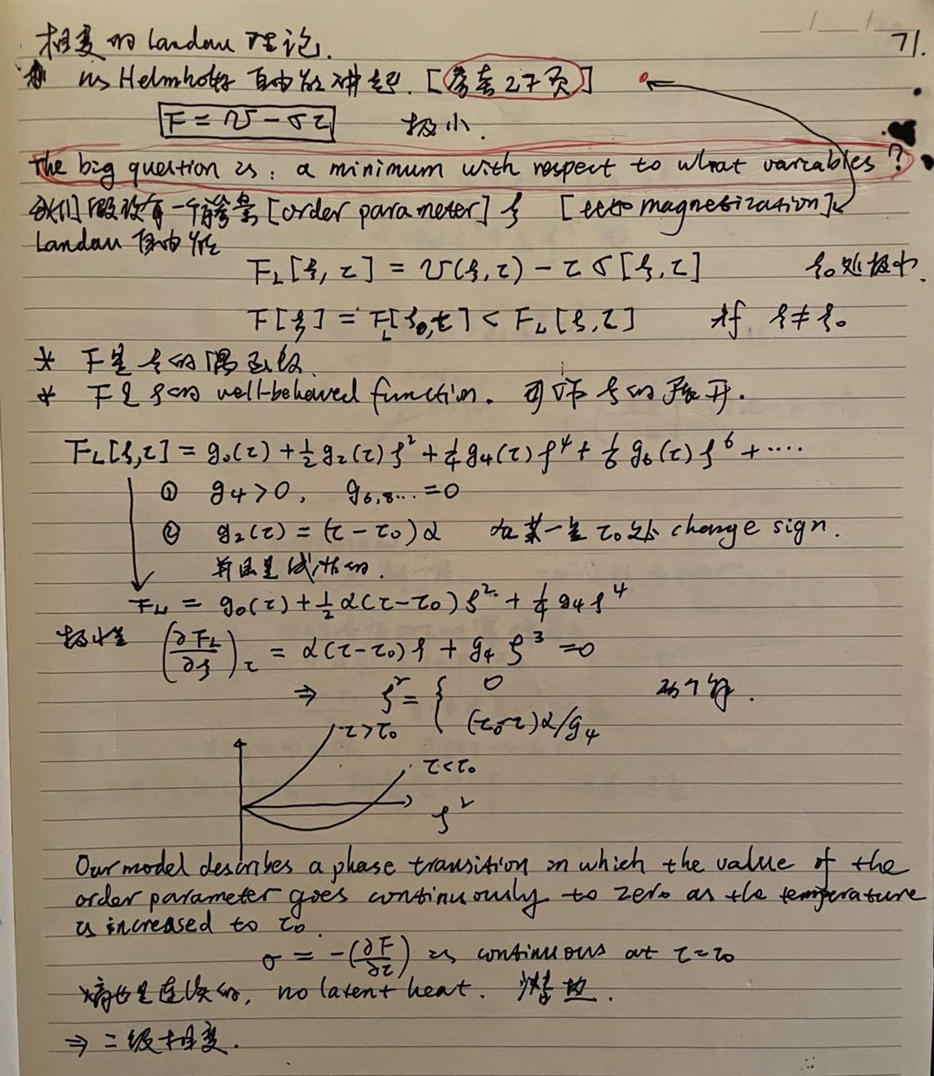
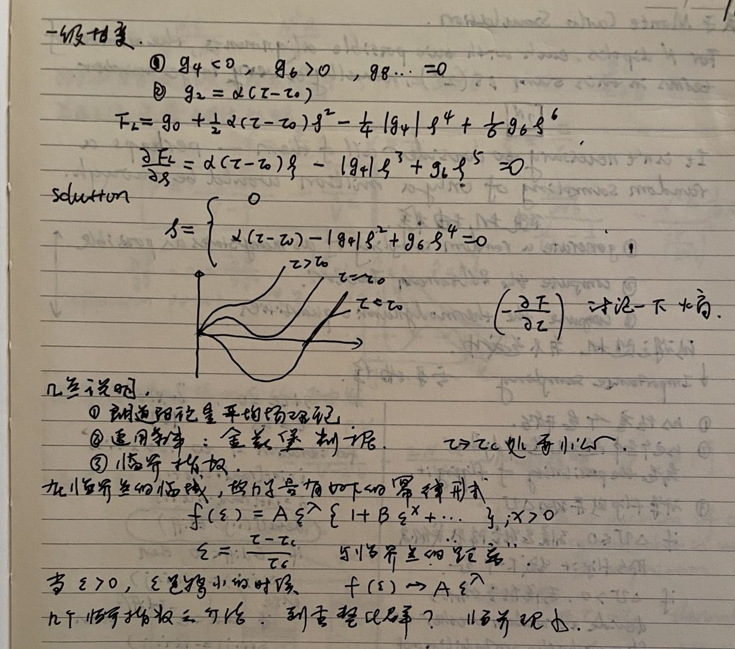

Slide 22
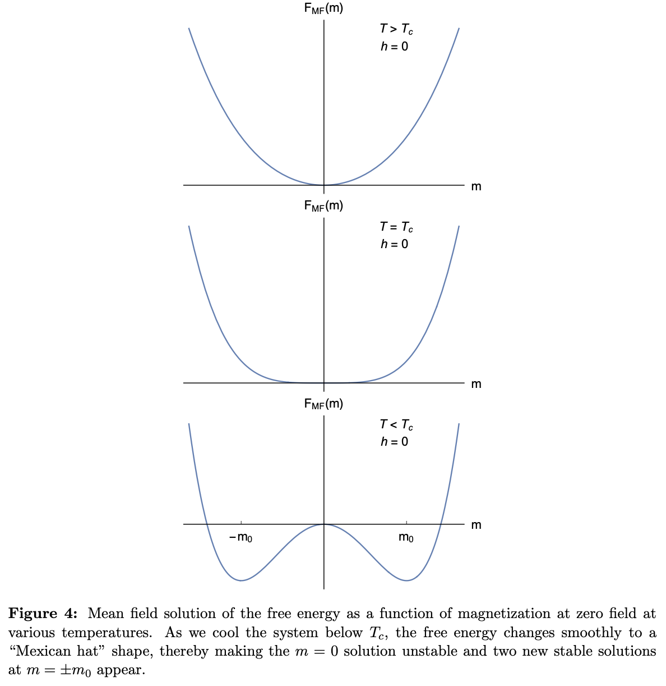
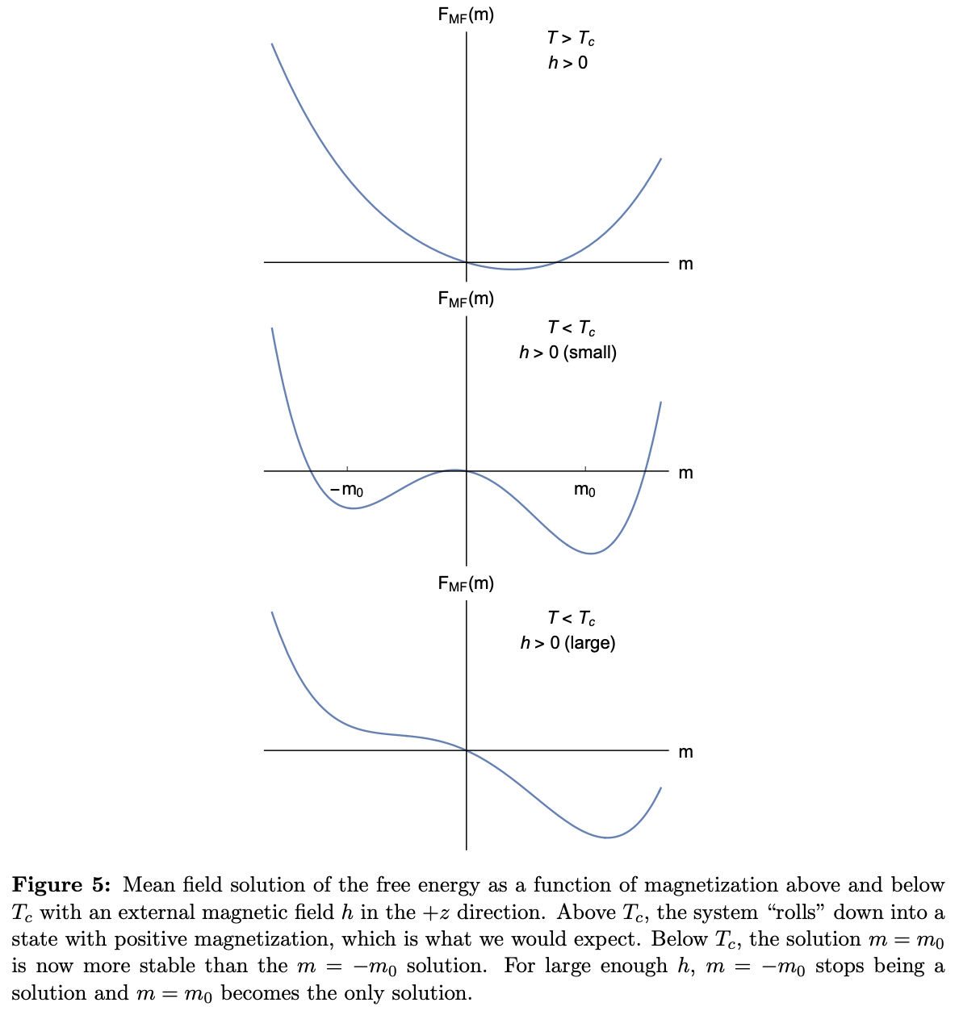

Slide 23
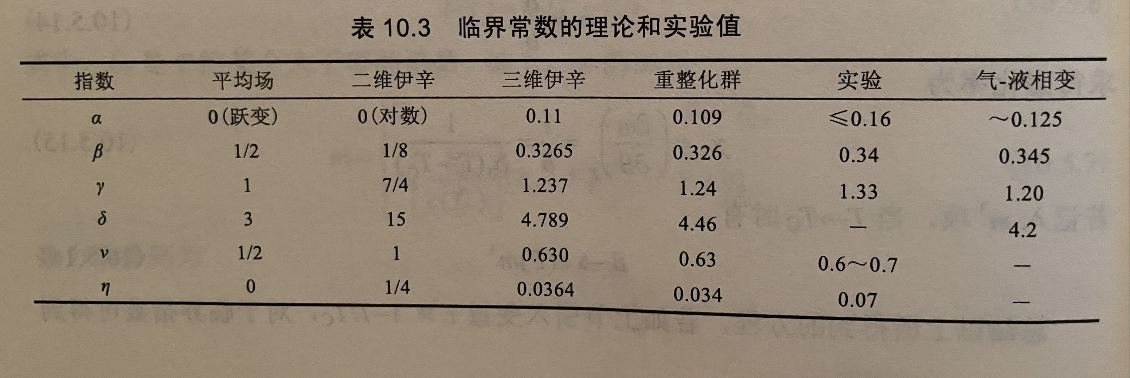

临界指数
序参量
$$m∝t^{β=\frac{1}{2}}$$
磁化率
$$χ∝{|t|}^{−γ=−1}$$
热容
$$C∝{|t|}^{−α=0}$$
等等

Slide 24
标度变换与普适性？？
2022.05.22

